Slide 1
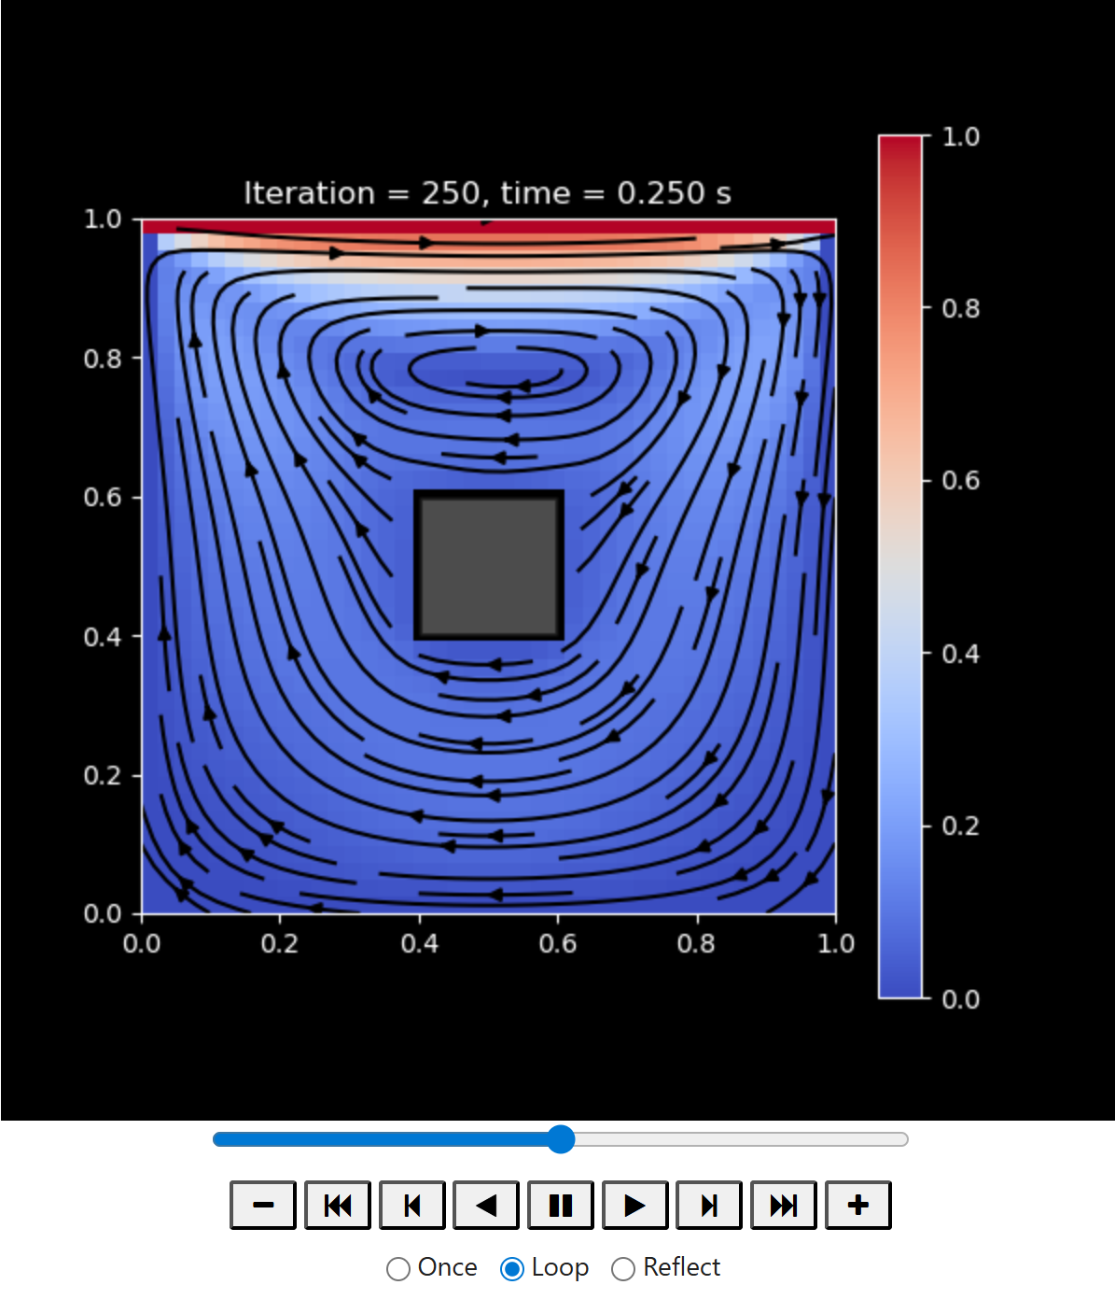
Lid-driven Cavity with obstacle: Project Milestone
Tiffany W & Evelyn Jane

Slide 2
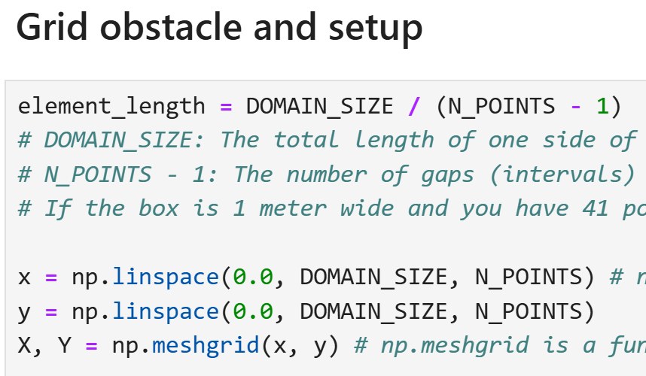


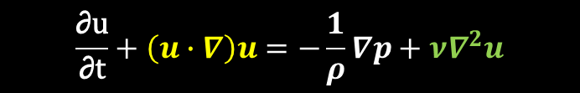
Phase 1: Mathemathical formulation & discretetization
$$\frac{\text{∂}\text{u}}{\text{∂}\text{t}}+\left(u∙∇\right)u=−\frac{1}{ρ}∇p+ν∇^{2}u$$
1.1 Definition of Governing Equations: Formulating the 2D Incompressible Navier-Stokes equations into the Streamfunction-Vorticity (Ψ - ω) transport system.
Status: Finished
By: Evelyn
1.2 Mesh Grid Generation: Discreting the continuous domain into a uniform Cartesian grid ($Nx×Ny$) and defining the spatial steps (dx, dy) and time-step (dt) based on the stability criteria.
Status: Finished
By: Evelyn
$$∇∙u=0$$
Notes:
Before a computer can simulate fluid passing around an obstacle inside a box (the cavity), it needs to know the laws of physics.
Subtask 1.1 represents the Mathematical Formulation. In computational fluid dynamics (CFD), fluid flow is governed by the Navier-Stokes equations (which are basically Newton's $F=ma$ applied to liquids). To turn these complex calculus equations into something a standard computer loop can understand, they are mathematically rearranged into the Streamfunction-Vorticity ($\psi$-$\omega$) formulation.
Vorticity ($\omega$): Measures how much the fluid is spinning or swirling (especially around the corners of your obstacle).
Streamfunction ($\psi$): Helps track the actual path lines that particles in the fluid follow.
Computers cannot solve fluid dynamics equations continuously. They require space to be broken down into a discrete grid of data points.
In Subtask 1.2, we specify the real-world sizing parameters and construct the mathematical coordinate mesh matrix ($N_x \times N_y$). Think of it as creating a digital graph-paper layout inside the box so the program knows exactly where the fluid particles are located at any given index point.

Slide 3
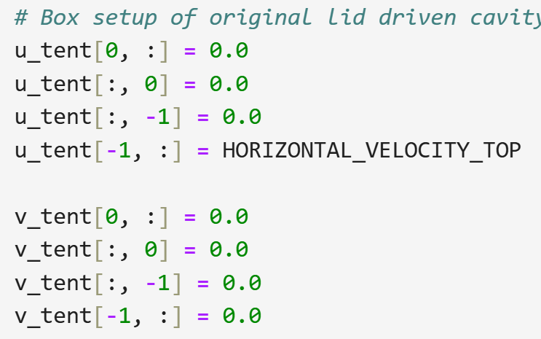
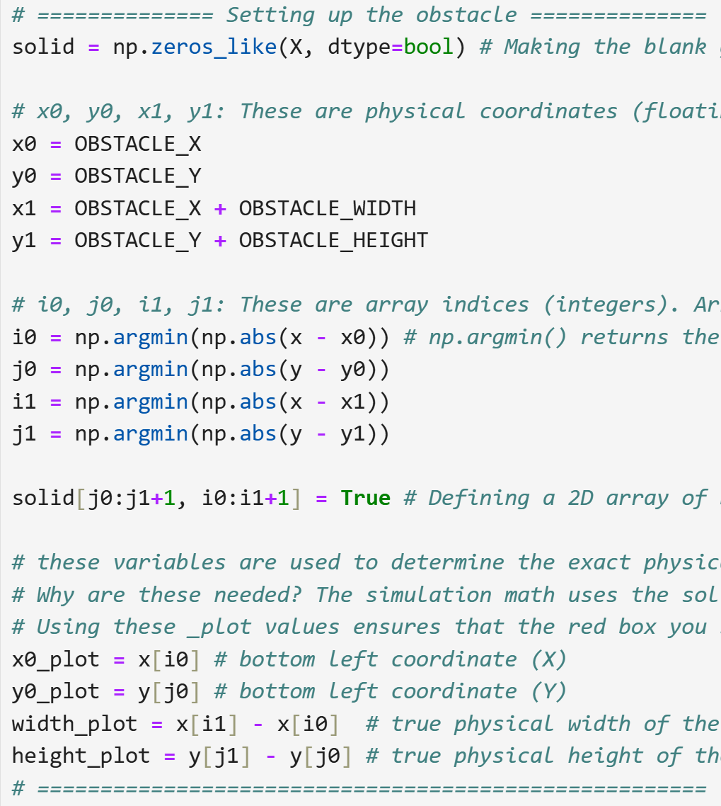
Phase 2: Boundary conditions & Obstacle masking
2.1 Lid & Moving Wall Boundary Constraints: Coding the Dirichlet and Neumann boundary conditions (e.g., no-slip conditions at the bottom/side walls and the constant velocity at the top surface.
Status: Finished
By: Tiffany
2.2 Solid Obstacle Masking Matrix: Designing a static boolean/integer mask matrix to isolate nodes falling inside the central obstacle coordinates.
Status: Finished
By: Tiffany
Notes:
For fluid to swirl inside a box, something needs to drive it. In this system, the side walls and the bottom floor are completely static (zero velocity, also known as the No-Slip boundary condition). The top lid, however, is constantly sliding to the right at a constant forward velocity (HORIZONTAL_VELOCITY_TOP = 1.0).
Subtask 2.1 represents the code lines that explicitly pin these dynamic velocity limits on the matrix edge boundaries at every calculation tick.
To introduce an obstacle inside the walls of the cavity, the code must track exactly which positions in space are fluid (where water can flow) and which are solid block (the wall).
To do this, the script creates a dedicated 2D tracking grid (solid) filled entirely with true/false Boolean conditions. Then, it calculates the raw coordinate conversions to find the exact box space matching your design parameters and overwrites those matching block dimensions to True.

Slide 4
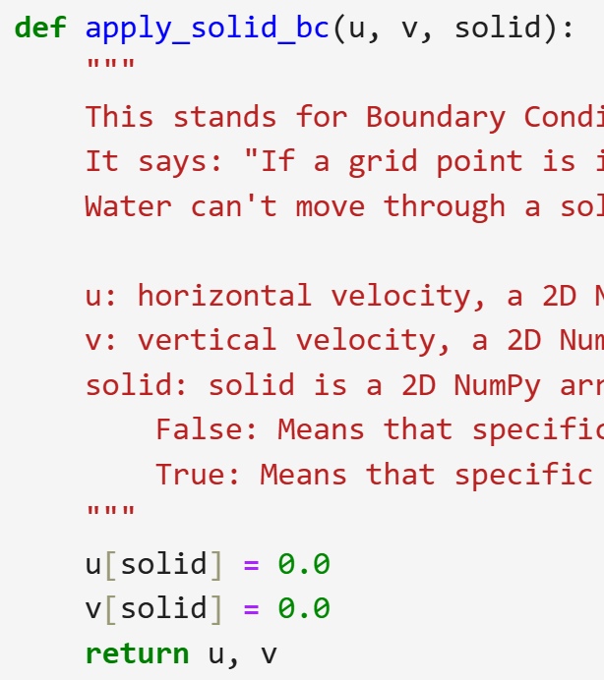
Phase 2: Boundary conditions & Obstacle masking
2.3 Obstacle No-Slip Implementation: Enforcing strict zero-velocity and zero-streamfunction boundaries specifically along the outer perimeter of the interior obstacle.
Status: Finished
By: Tiffany
Notes:
Even though Subtask 2.2 created the boolean mask map (solid), the math solver doesn't inherently know that "True" means a solid block—it will still try to calculate fluid passing right through those array coordinates.
Subtask 2.3 is where you enforce the No-Slip and Impenetrability boundary conditions specifically for that internal obstacle. It forces the horizontal velocity (u) and vertical velocity (v) at every coordinate marked as solid to instantly overwrite to 0.0. This forces the fluid to bend, split, and flow around the object instead of cutting through it.

Slide 5
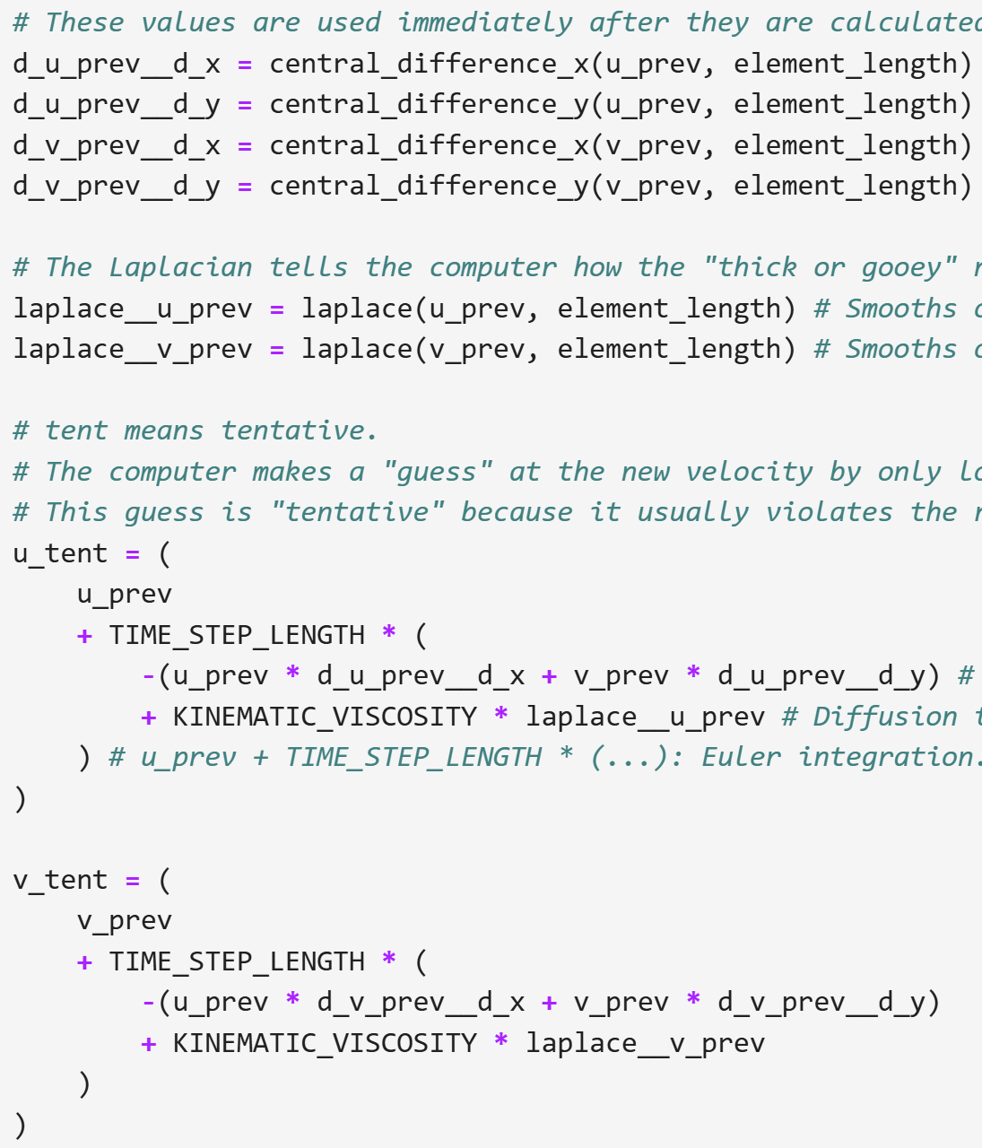
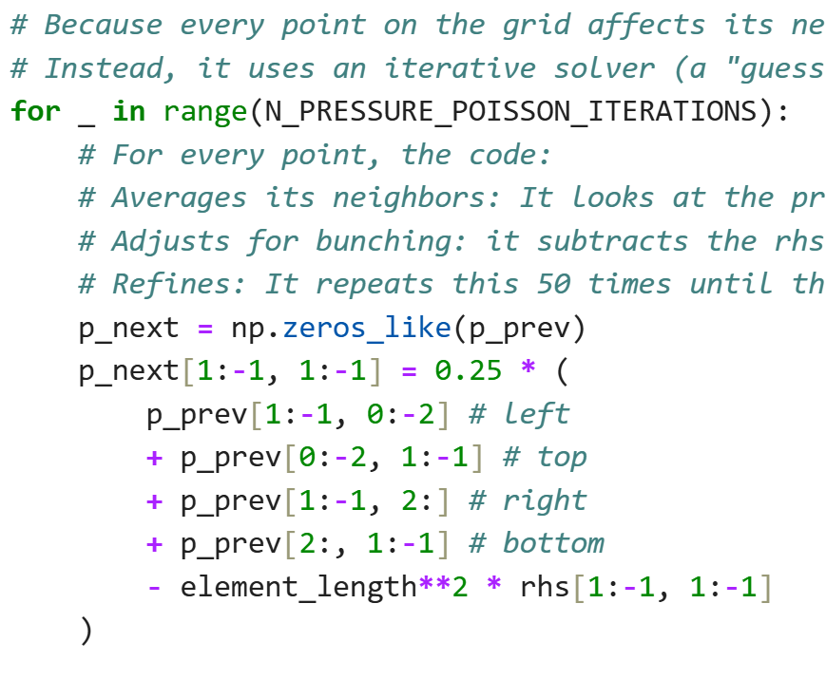
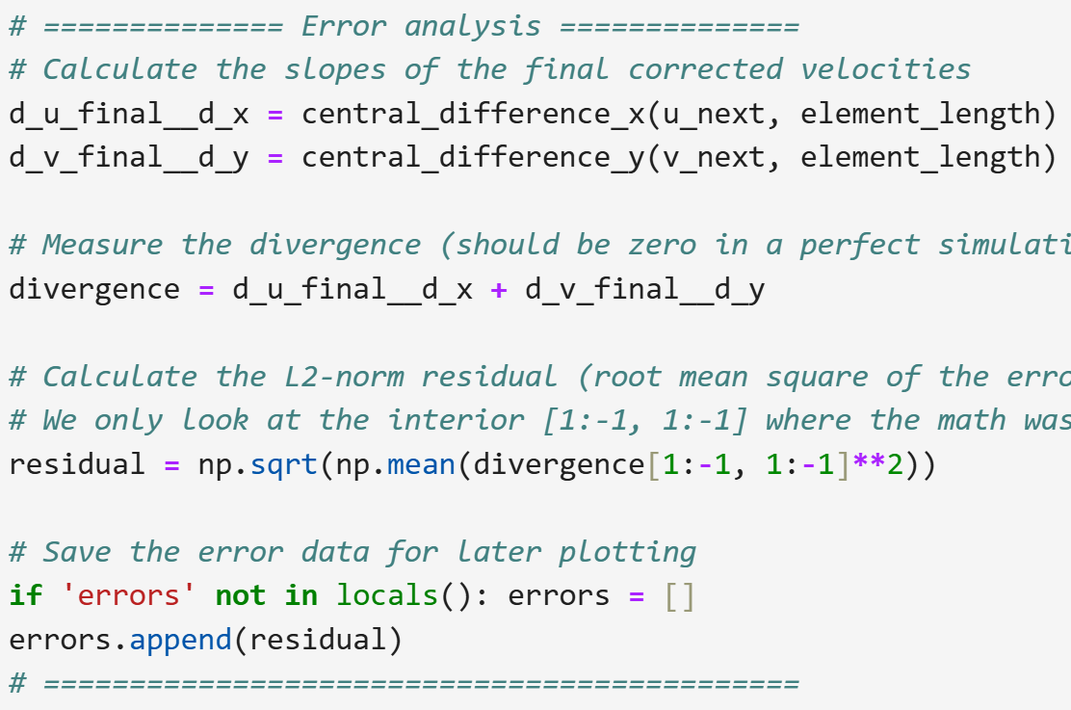
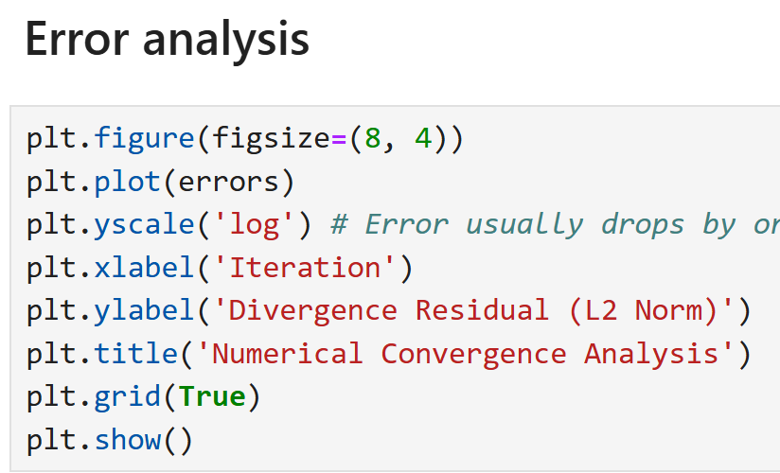
Phase 3: Solver Engine & Iterative Loops
3.1 Vorticity Transport Step: Implementing a Finite Difference Method (FDM) scheme to explicitly advect and diffuse vorticity at each time step.
Status: Finished
By: Tiffany
3.2 Poisson Solver for Streamfunction: Setting up an iterative relaxation solver to compute the streamfunction Ψ from the new vorticity field.
Status: Finished
By: Tiffany
3.3 Residual Tracking & Convergence: Setting up an error metric tracker (errors.append()) monitored on a logarithmic scale to guarantee convergence limits are met before exiting loops.
Status: Finished
By: Tiffany
Notes:
In a Streamfunction-Vorticity fluid scheme, fluid flow changes over time because of two physical forces acting on the vorticity ($\omega$):
Advection: The fluid's own velocity vectors (u and v) physically push and drag the rotational swirl profiles sideways across the grid points.
Diffusion: The internal molecular friction of the liquid (the fluid thickness, mapped by KINEMATIC_VISCOSITY) naturally smooths out sharp velocity differences over time.
Subtask 3.1 utilizes the mathematical spatial gradients built in 1.1 to move the fluid grid forward by a tiny fraction of time (TIME_STEP_LENGTH).
Once Subtask 3.1 calculates how much the fluid is swirling around at the new time step, the model must figure out how the physical speed maps onto streamline curves ($\psi$). Mathematically, this requires solving an elliptic differential rule known as the Poisson equation ($\nabla^2\psi = -\omega$).
Because computers cannot resolve these multi-directional dependency grids instantly, you use a relaxation scheme. The code takes the previous state as a starting point, guesses the new balance values, evaluates the errors against neighbor arrays, and repeats this update process 50 times per step to "relax" into a stable stream field.
When you solve fluid dynamics equations iteratively, you need a way to verify that your answers are actually approaching a correct physical state rather than exploding into random numbers (a common issue in fluid codes).
Subtask 3.3 is about tracking residuals—which are the calculated differences between the current fluid state and the previous step's fluid state. By storing these errors in a list and plotting them on a logarithmic scale, you prove to your instructor that the system stabilized (converged) and reached a valid steady-state solution.

Slide 6
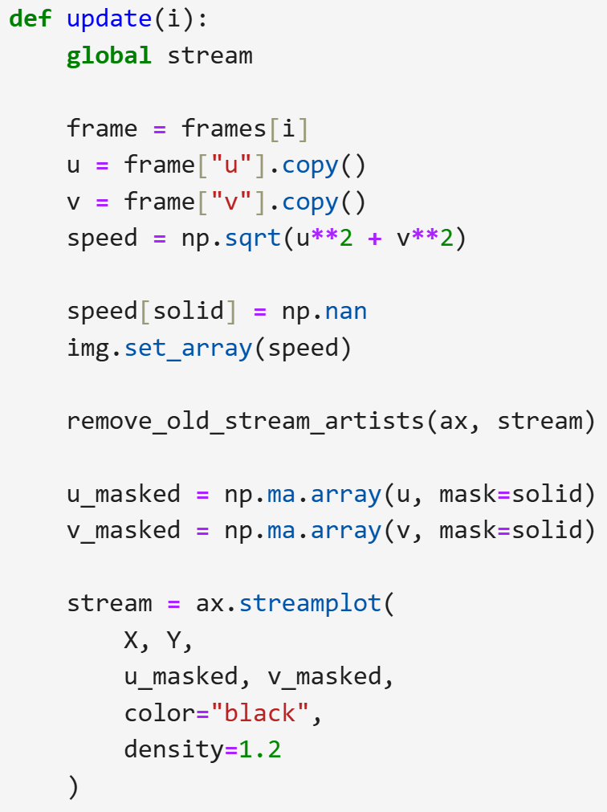
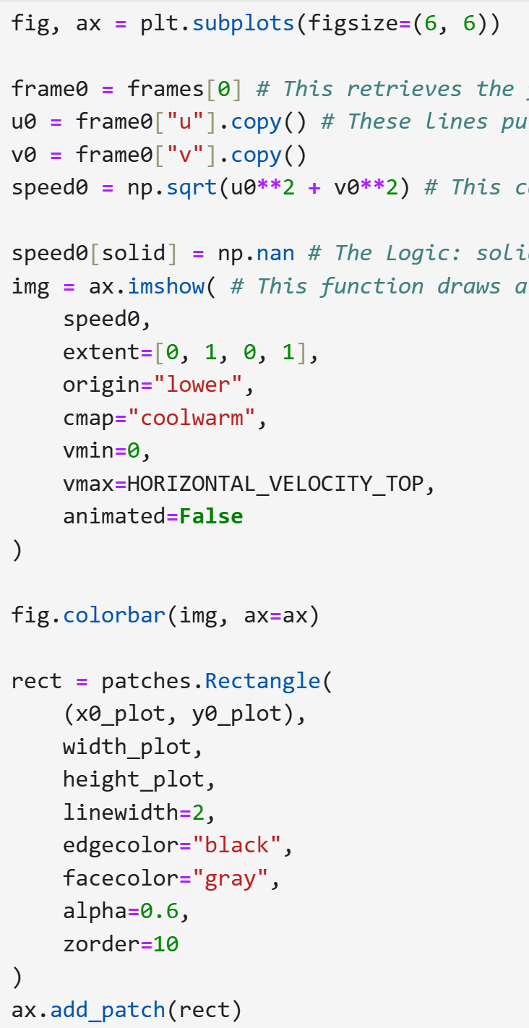
Phase 4: Post-Processing & Visualization
4.1 Vector Field & Streamline Extraction: Reconstructing horizontal (u) and vertical (v) components from the streamfunction to generate velocity vector fields.
Status: Finished
By: Evelyn
4.2 Static Field Contour Plotting: Utilizing Matplotlib to draw contour maps for both the pressure/streamline profiles and the high-vorticity zones forming around the sharp corners of the obstacle.
Status: Finished
By: Evelyn
Notes:
Up until this point, the solver loop has just been crunching a bunch of numbers in separate matrix grids (a 2D matrix for horizontal speeds $u$, and a 2D matrix for vertical speeds $v$).
Subtask 4.1 is where you extract those independent speed arrays, combine them to find the true overall magnitude (speed) at any given coordinate, apply your obstacle mask so lines don't get drawn inside the solid box, and use a numerical tracer algorithm (plt.streamplot) to trace continuous fluid pathways (streamlines) around the obstacle.
Before throwing an animation onto a screen, a computational physics model needs a configured canvas wrapper. Subtask 4.2 focuses on generating a high-fidelity snapshot setup that visualizes magnitude distributions (like velocity speed or pressure variations) across the spatial geometry.
By applying an image mapping function (imshow) along with a customized bounding box shape (patches.Rectangle), this step creates a standardized backdrop where a color gradient scale map (from slow blue to rapid red) visually isolates the physical placement and impact of the central obstacle.

Slide 7
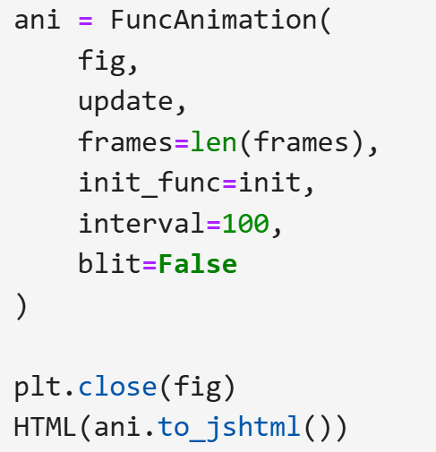
Phase 4: Post-Processing & Visualization
4.3 Temporal Dynamic Animation: Implementing FuncAnimation to render an exportable video capturing the evolution of the fluid flow from its rest state to a fully developed steady state.
Status: Finished
By: Evelyn
Notes:
A static picture only shows fluid patterns at one fixed point in time (like the final steady state). However, fluid physics are deeply temporal: when the top lid suddenly starts sliding, waves and vortices slowly crop up, warp around the obstacle, and change shape before settling down.
Subtask 4.3 is about taking your historic frames list variable, building an automated update engine (def update(i):), and passing it into a compiler that automatically strings those individual array snapshots into an interactive web-based animation movie (HTML(ani.to_jshtml())).

